Slide 1


APPLE MART: Your One-Stop Online Shopping Destination
Discover an effortless online shopping experience with Applemart. Explore our curated selection of products and find everything you need in one place.

Slide 2

Intuitive User Experience
Effortless Navigation
Simple Interface
Seamlessly browse through various product categories and filter options.
Intuitive design makes it easy to find what you need, no matter your tech expertise.
Responsive Design
Enjoy a smooth shopping experience on any device, from desktop to mobile.

Slide 3
Comprehensive Product Catalog
Diverse Selection
Detailed Information
High-Quality Images
Find a wide variety of products across various categories.
Read comprehensive product descriptions, specifications, and customer reviews.
View high-resolution images and videos of products for a clear visual understanding.

Slide 4

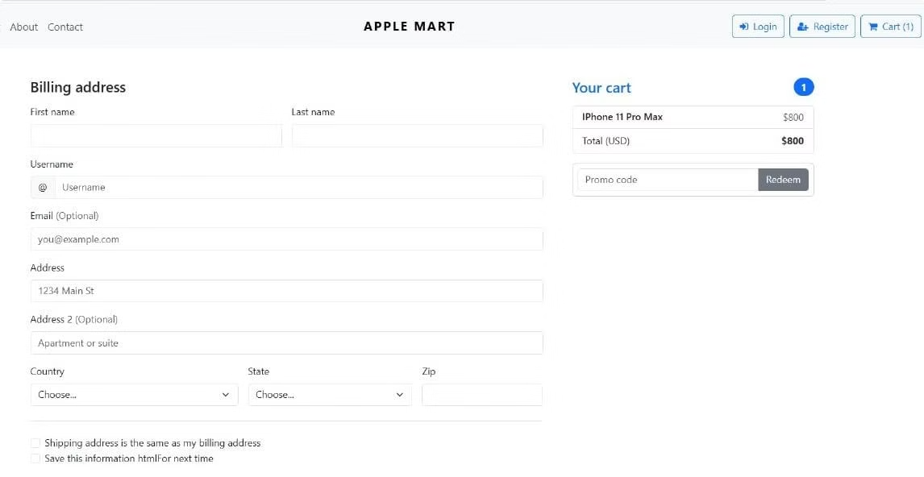
Informed Purchasing Decisions
1
Comparison Tools
2
Customer Reviews
Compare similar products side-by-side to make the best choice for your needs.
Read authentic customer reviews and ratings for an unbiased perspective.
3
Price Comparisons
View pricing history and compare prices from different sellers to find the best deal.

Slide 5

Secure and Seamless Checkout
Secure Payment Gateway
Utilize industry-standard encryption technology to protect your sensitive information.
Easy Order Tracking
Track your order status and receive real-time updates.
1
2
3
Multiple Payment Options
Choose from a variety of convenient and secure payment methods.

Slide 6




Instant Order Confirmation
Confirmation Email
Receive an instant email confirming your order with all the details.
Order Tracking
Access your order status in real-time through a personalized tracking link.
Customer Support
Contact our friendly customer support team for any questions or concerns.

